Slide 1
History communication skills

Slide 2
Elements of Communication
Sender Receiver
Feedback
Message
Notes:
Teacher Notes:
Describe the elements of the communication model.

Slide 3
start
Wipe
Wash hands
Introduce self (full name and grade)
Patients name and date of birth and what they like to be called
Explain why you are here

Slide 4
Briefly mention confidentiality
Start with an open question and try not
interrupt patients answer

Slide 5
Invite ,listen ,summarize –ILS) ) During
start with open question and progress to closed question
build a rapport
use signposting
Show empathy
Response to cues
listen to what patients are saying
Don’t think of the next question
Cues may be verbal or non verbal body language
Repeat a cue and ask more about

Slide 6
End
Summarize
Ask if they have any question
Explain the next steps

Slide 7
Integrate ideas , concern and expectation (ICE)
Never
Ask leading questions
Give multiple answers /questions in on go

Slide 8
Key tips for communicating with examining children
Major points
Keep using their names
Make it a game
Keep interacting and asking questions

Slide 9
Other tips
If the child crying , let them calm down
Involve child when ever possible
Even babies like to hear reassuring voice
Befriend child before examining
Get at their level
Distract with toes
Use parents to distract them
Undress in stages
Reward child and praise them
Etc..

Slide 10
Create a rapport quickly
Introduce self to every one in the room
Refer to the patient by name
Acknowledge wait
Make social comment or ask non medical question
Convey knowledge of pt’s history by comment on prior visit or problems
Consider patients cultural background and use appropriate gestures, eye contact, and body language

Slide 11
Summary
Quality of care depends a lot on good communication with families
Good communication depends a lot on listening to our patients and showing empathy.
Good listening means good care.
Parents are not looking for how much you know but how much do you care.

Slide 12
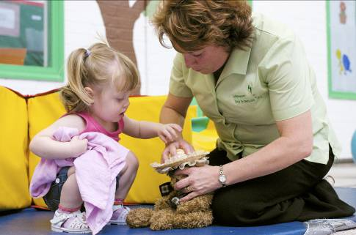
Thanks for listening

